Slide 1

Learning Traffic Deeply as Images with Partially Observed Data
Travel Time Prediction on I-80 E from Davis to West Sacramento
Jin Guo
06/04/2019

Slide 2
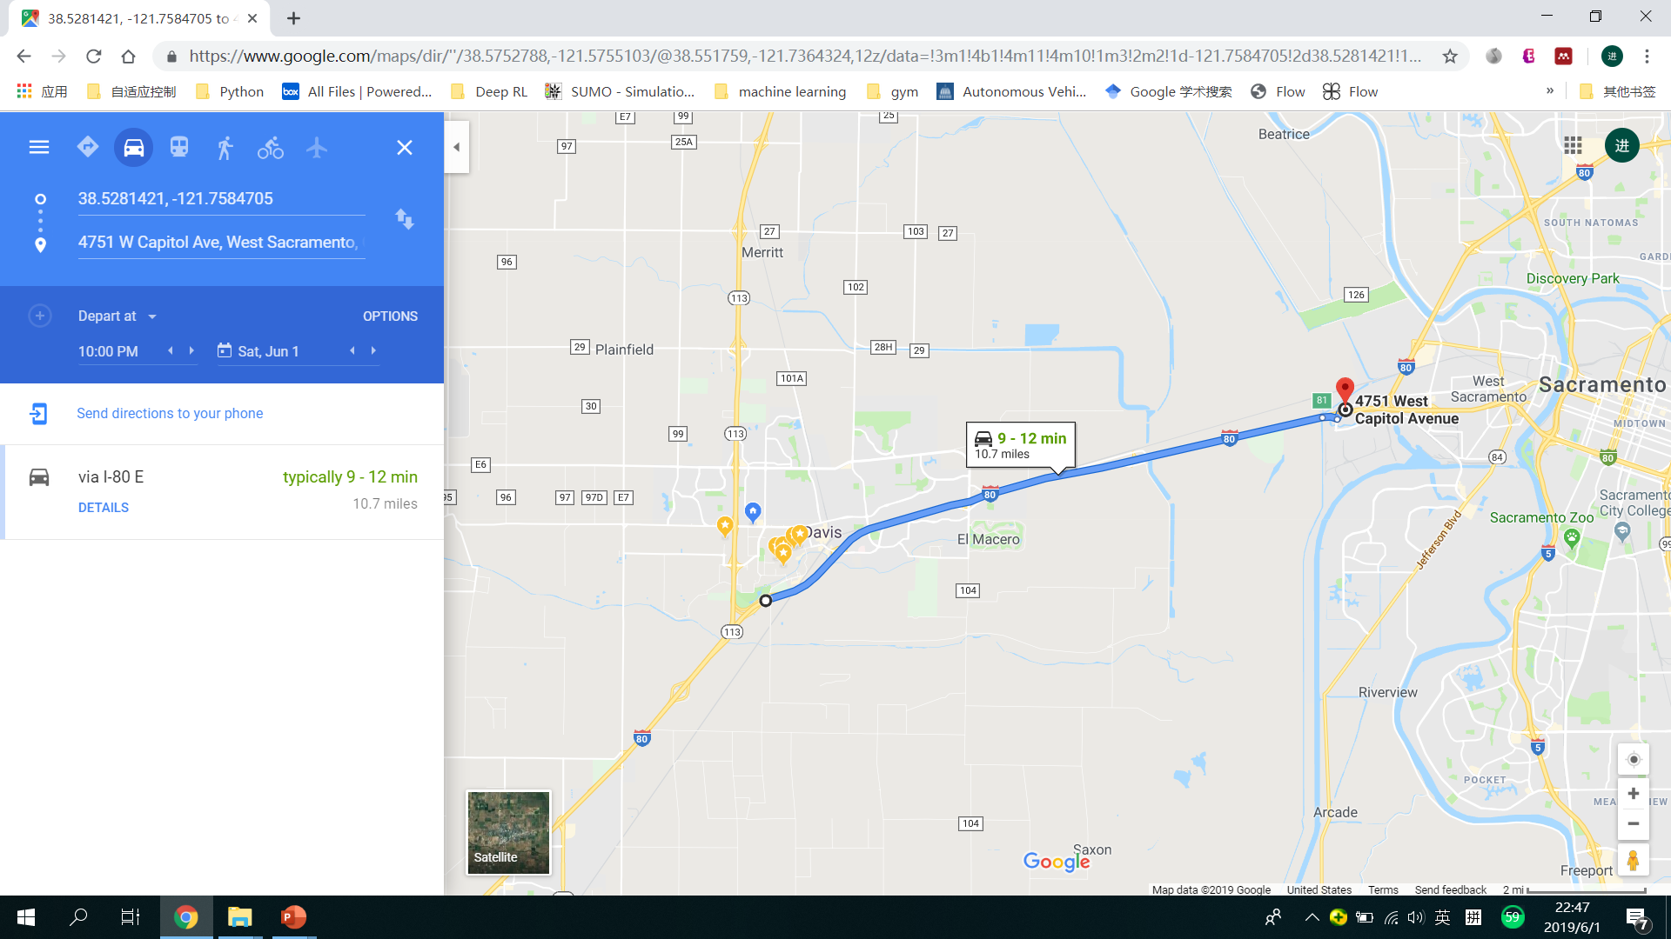

Travel Time
May 31, Friday, 7:00 AM
May 31, Friday, 4:00 PM
How is the color shown in Google Map related to our travel time?

Slide 3
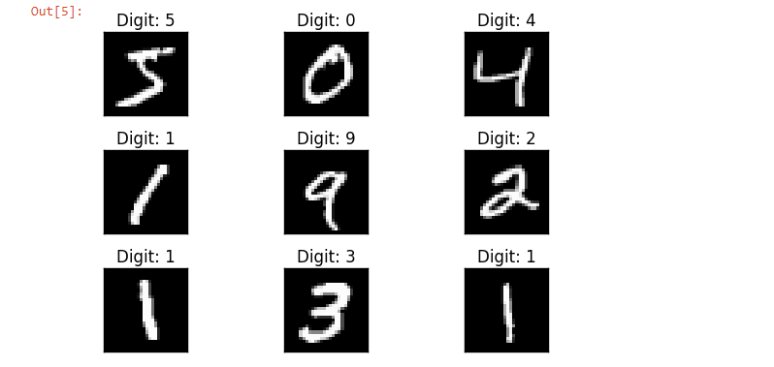
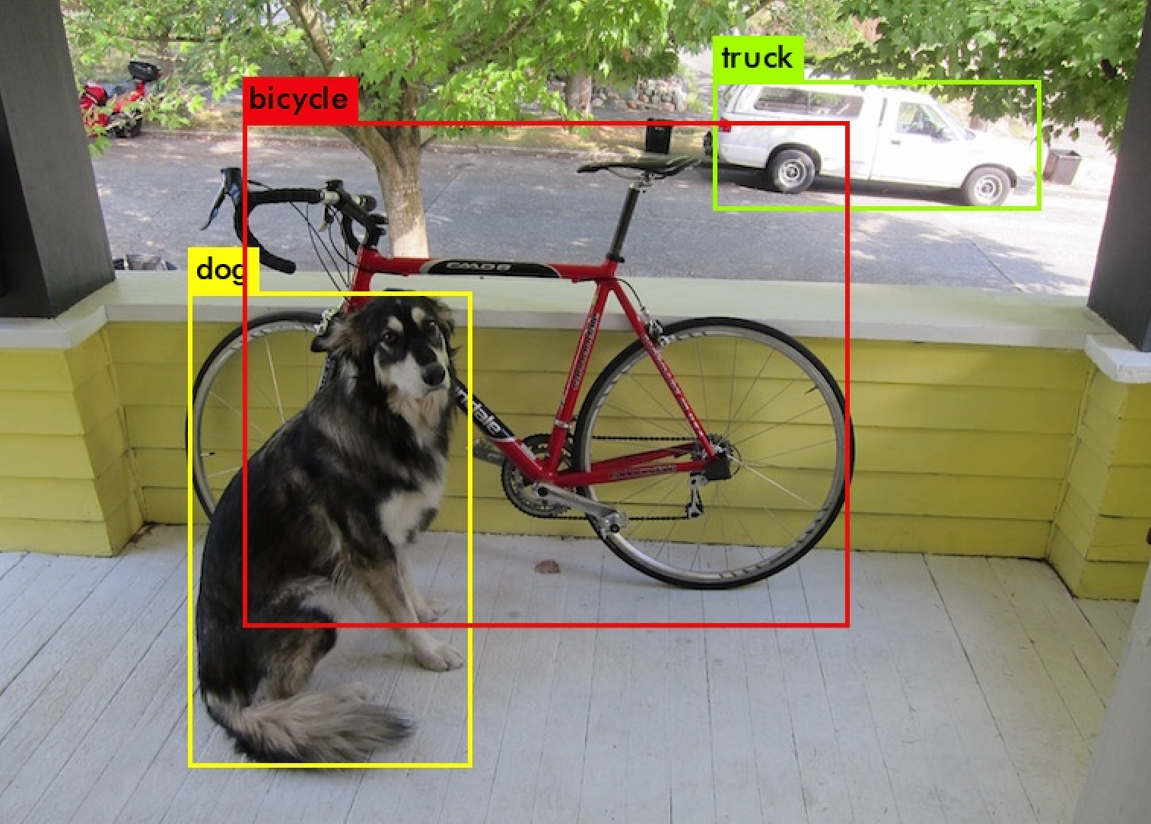
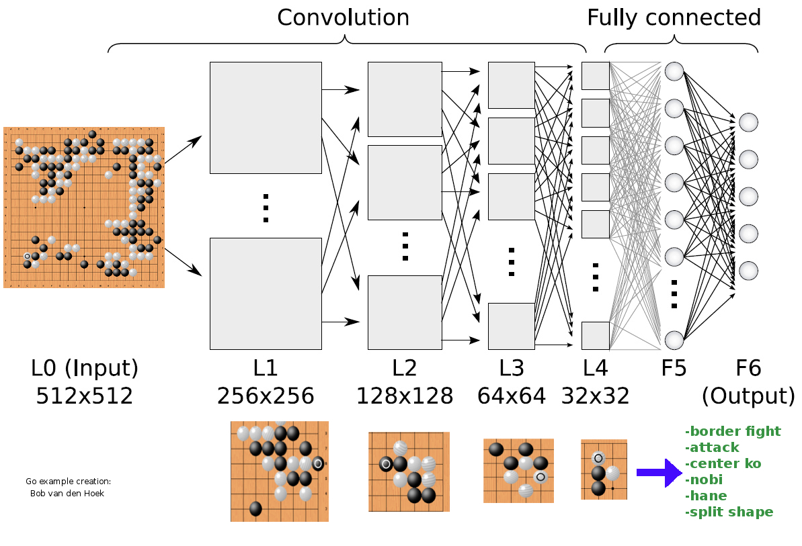
What Computer Vision Can Do Now?
Recognition of Hand Written Digits
Classification of Objects
Master of Go Games
Source: MNIST Data Set
Source: YOLO v3
Source: http://deeplearningskysthelimit.blogspot.com/2016/04/part-2-alphago-under-magnifying-glass.html
Is there another magic box that can tell us how many time we will spend on the road?

Slide 4



Three Steps to Build the Black Box
Collect and Preprocess Data
Convert Traffic Information to Images
Design and Train the Prediction Model

Slide 5
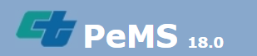
Data Collection
Caltrans Performance Measurement System (PeMS)
Vehicle Detector Station (VDS)
15 VDSs in the selected freeway segment

Slide 6
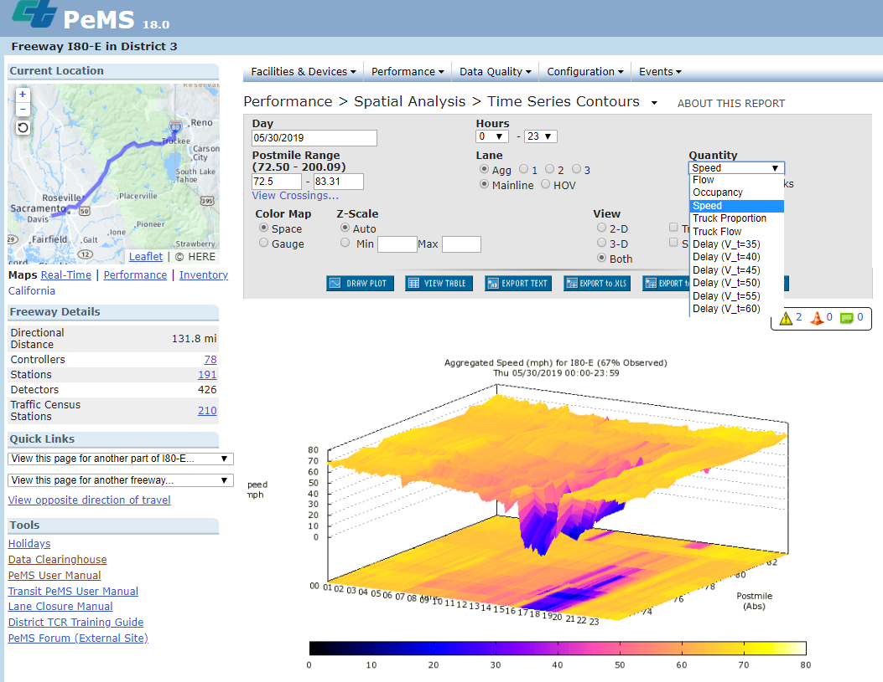
Data Collection
Time | AggOccupancy | AggFlow | AggSpeed | % Observed
00:00 | 0.01 | 40 | 67.40 | 100.00
00:05 | 0.01 | 19 | 67.40 | 100.00
00:10 | 0.02 | 43 | 67.30 | 100.00
00:15 | 0.01 | 68 | 68.00 | 0.00
00:20 | 0.01 | 89 | 67.40 | 100.00
00:25 | 0.01 | 67 | 67.40 | 100.00
00:30 | 0.04 | 68 | 67.40 | 100.00
00:35 | 0.02 | 76 | 67.40 | 100.00
00:40 | 0.02 | 67 | 67.40 | 0.00
00:45 | 0.03 | 97 | 67.40 | 100.00
00:50 | 0.02 | 59 | 67.40 | 100.00
00:55 | 0.04 | 57 | 67.40 | 100.00
01:00 | 0.02 | 0 | 67.40 | 33.33
01:05 | 0.02 | 68 | 67.40 | 100.00
Time
Occupancy
Flow
Speed
Observation rate
X 15 VDSs
X 17 + 1 + 1 Days
Training
Set
Test Set 1
Test Set 2
Same Detector Health
Different Detector Health

Slide 7
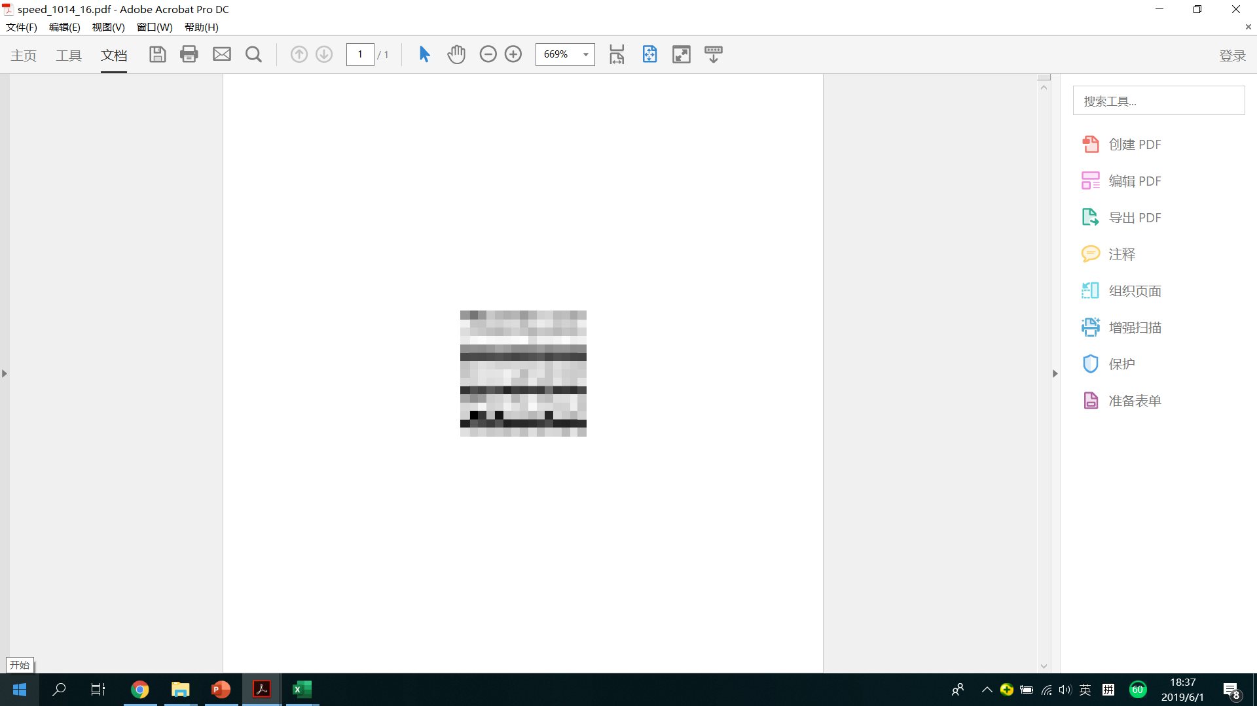



Convert Traffic Information to Images
VDS1
VDS2
….
pandas.read_excel( )
scipy.misc.imsave( )
VDS14
VDS15
t
t+5min …… t+5min*14

Slide 8
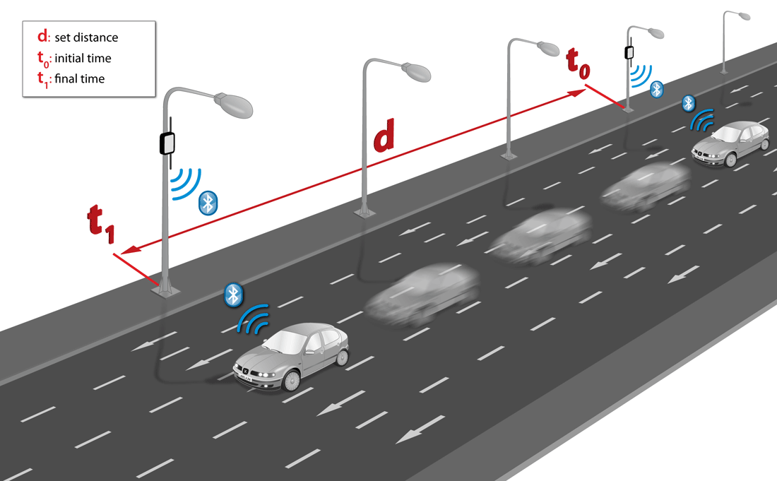

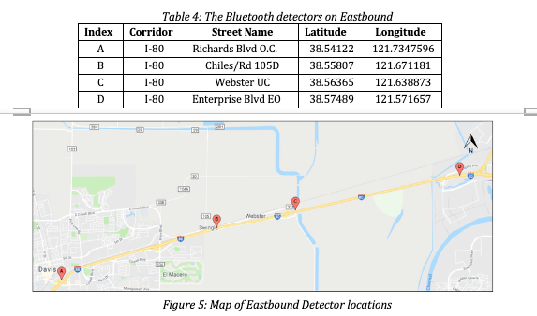
Travel Time Mesurement
V2I Technology
Source: https://icyapril.com/privacy/2016/11/21/tracking-drivers-through-their-phones.html
time | traveltime | segment | date
0.001991 | 185 | 80_Richards80_Chiles | 10/14/2018
0.002535 | 198 | 80_Richards80_Chiles | 10/14/2018
0.005081 | 181 | 80_Richards80_Chiles | 10/14/2018
0.005833 | 177 | 80_Richards80_Chiles | 10/14/2018
0.006701 | 206 | 80_Richards80_Chiles | 10/14/2018
0.007778 | 192 | 80_Richards80_Chiles | 10/14/2018
0.008368 | 222 | 80_Richards80_Chiles | 10/14/2018
0.009641 | 189 | 80_Richards80_Chiles | 10/14/2018

Slide 9
Travel Time Normalization
time | traveltime | segment | date
0.001991 | 185 | 80_Richards80_Chiles | 10/14/2018
0.002535 | 198 | 80_Richards80_Chiles | 10/14/2018
0.005081 | 181 | 80_Richards80_Chiles | 10/14/2018
0.005833 | 177 | 80_Richards80_Chiles | 10/14/2018
0.006701 | 206 | 80_Richards80_Chiles | 10/14/2018
0.007778 | 192 | 80_Richards80_Chiles | 10/14/2018
0.008368 | 222 | 80_Richards80_Chiles | 10/14/2018
0.009641 | 189 | 80_Richards80_Chiles | 10/14/2018
Every 5 minutes
Calculate mean μ and standard deviation σ
Aggregated Travel Time =
mean(i) for i >= μ - σ and i <= μ + σ

Slide 10
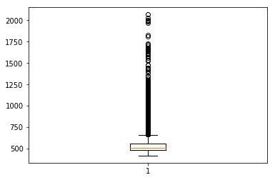
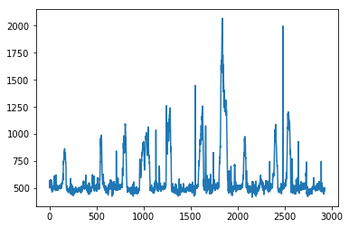
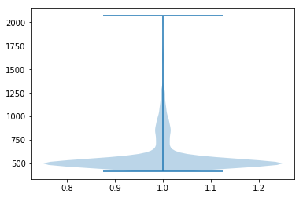
Travel Time Normalization
Box Plot of Travel Time
Time Series of Travel Time
Violin Plot of Travel Time

Slide 11
Travel Time Normalization
<450s
480s
510s
540s
570s
600s
630s
660s
690s
720s
>750s
0
1
2
3
4
5
6
7
8
9
Mph:
>80.0
75.0
70.6
66.7
63.2
60.0
57.1
54.6
52.2
50.0
<48.0
Regression → Classification

Slide 12

Pare Images with Travel Time
VDS1
VDS1
VDS2
VDS1
VDS1
VDS1
….
VDS1
….
….
….
….
….
VDS14
VDS14
Pytorch Tensors
VDS15
VDS14
VDS15
t
VDS14
t+5min …… t+5min*14
VDS15
t
VDS14
t+5min …… t+5min*14
VDS15
t
VDS14
t+5min …… t+5min*14
t
VDS15
t+5min …… t+5min*14
t
VDS15
t+5min …… t+5min*14
t
t+5min …… t+5min*14
TTt+5min*15
TTt+5min*15
TTt+5min*15
TTt+5min*15
TTt+5min*15
TTt+5min*15

Slide 13
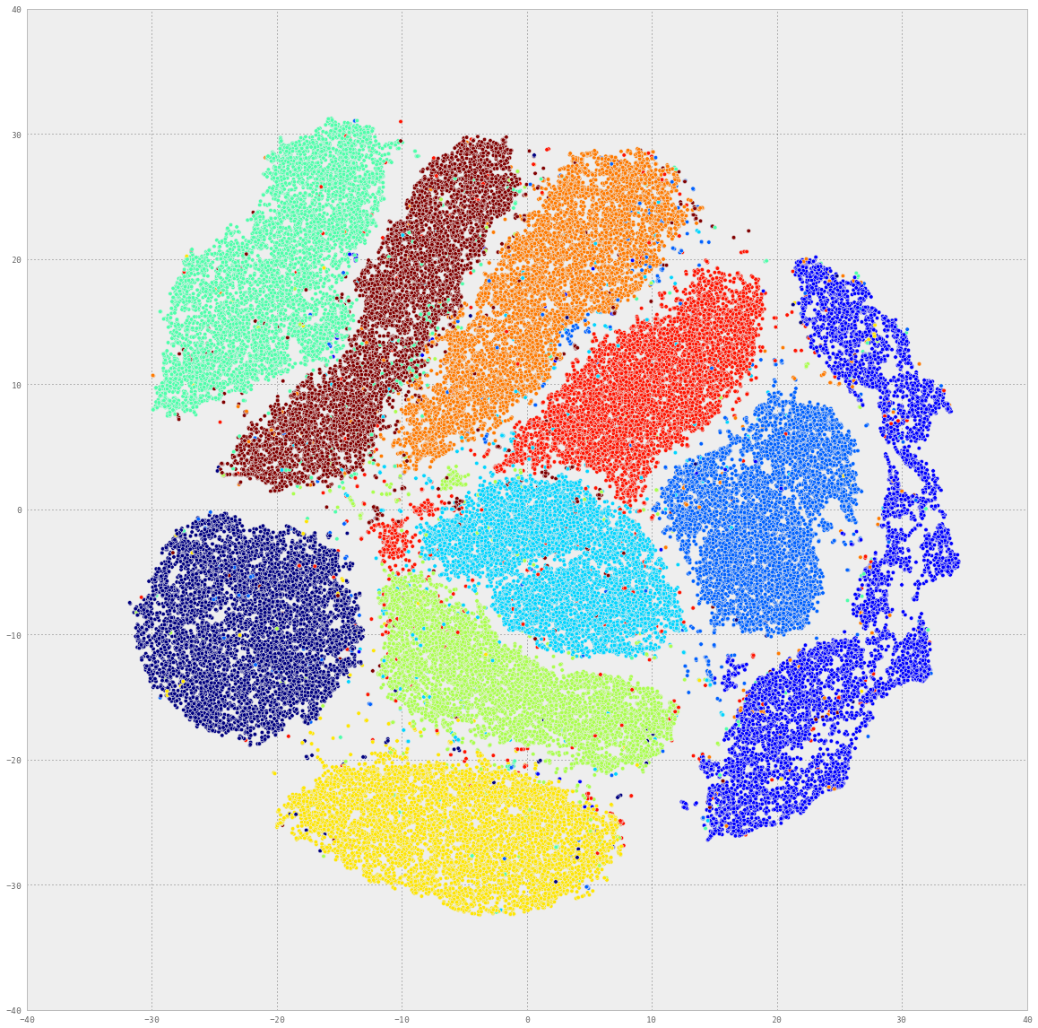
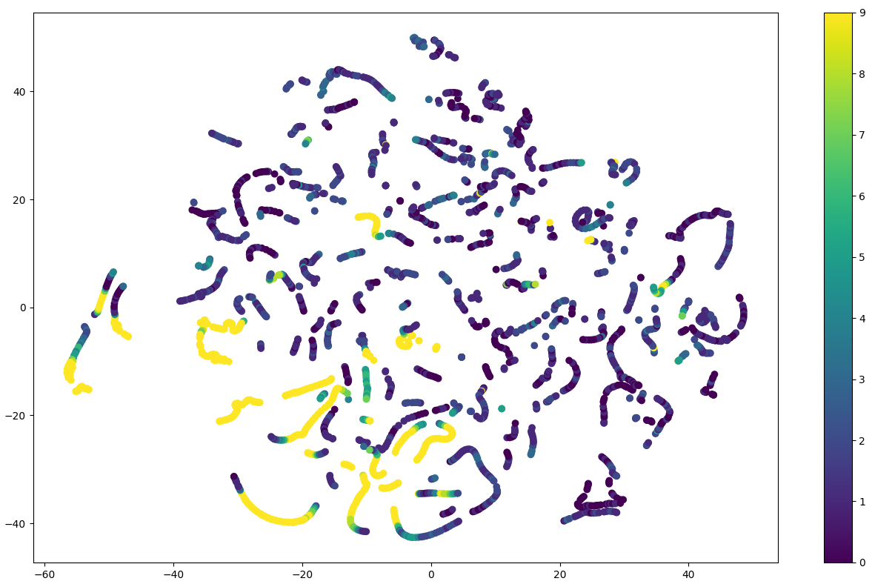
t - SNE
t-Distributed Stochastic Neighbor Embedding (t-SNE): visualization of high-dimensional datasets
Maaten, L. V. D., & Hinton, G. (2008). Visualizing data using t-SNE. Journal of machine learning research, 9(Nov), 2579-2605.
t – SNE for handwritten digits recognition
t – SNE for travel time prediction

Slide 14

Convolutional Neural Network (CNN)

Slide 15
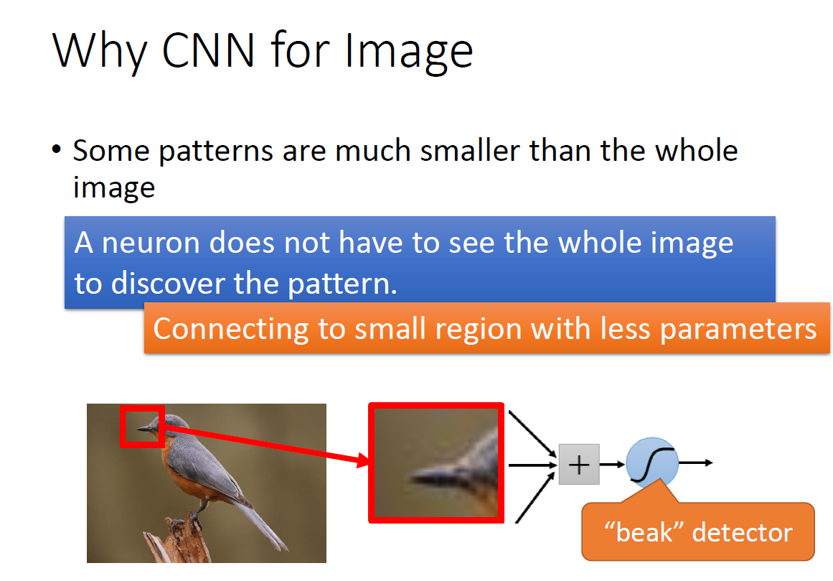
Convolutional Layers
Adjusted from Dr. Hung-yi Lee, Machine Learning slides

Slide 16
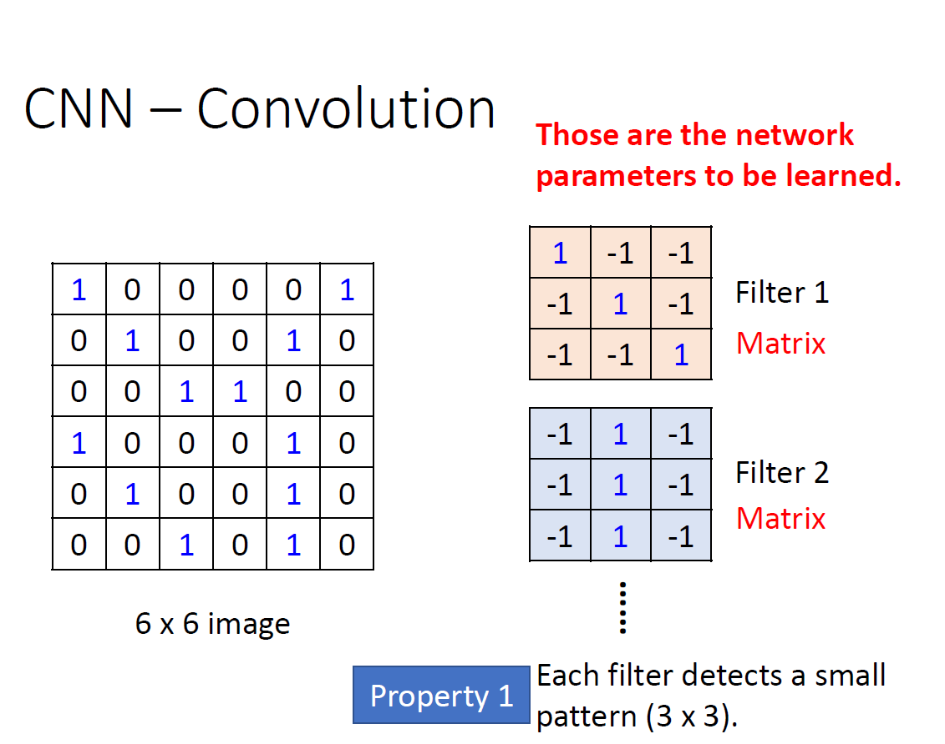
Convolutional Layers
Adjusted from Dr. Hung-yi Lee, Machine Learning slides

Slide 17
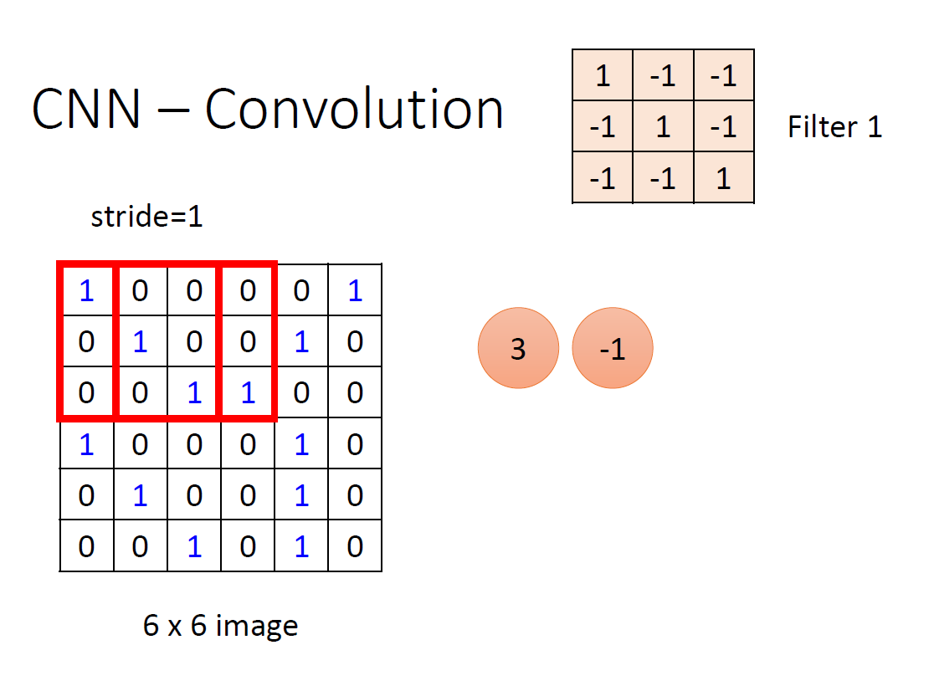
Convolutional Layers
Adjusted from Dr. Hung-yi Lee, Machine Learning slides

Slide 18
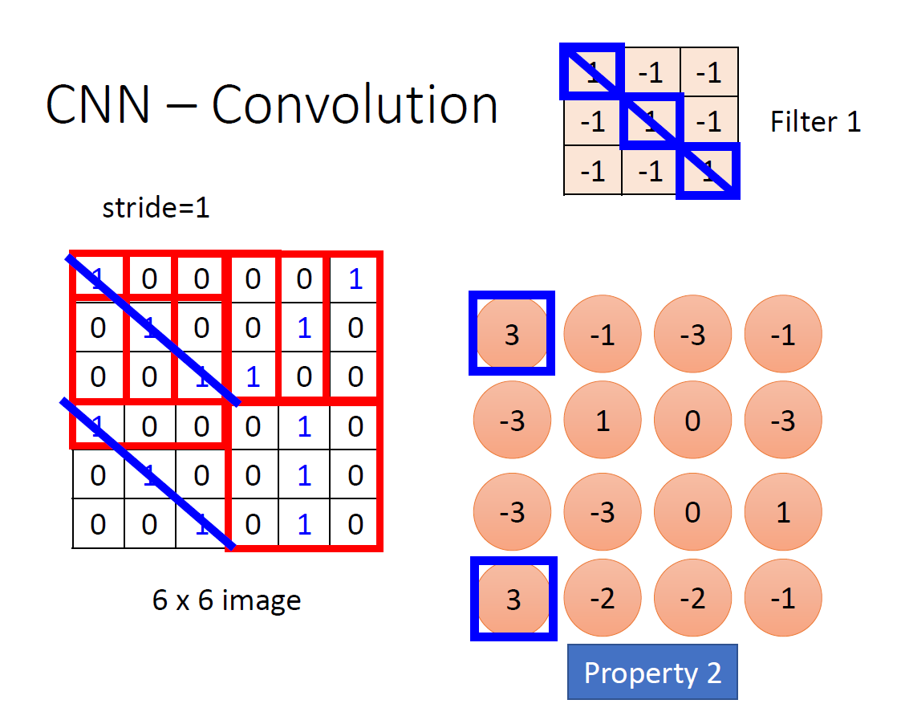
Convolutional Layers
Adjusted from Dr. Hung-yi Lee, Machine Learning slides

Slide 19
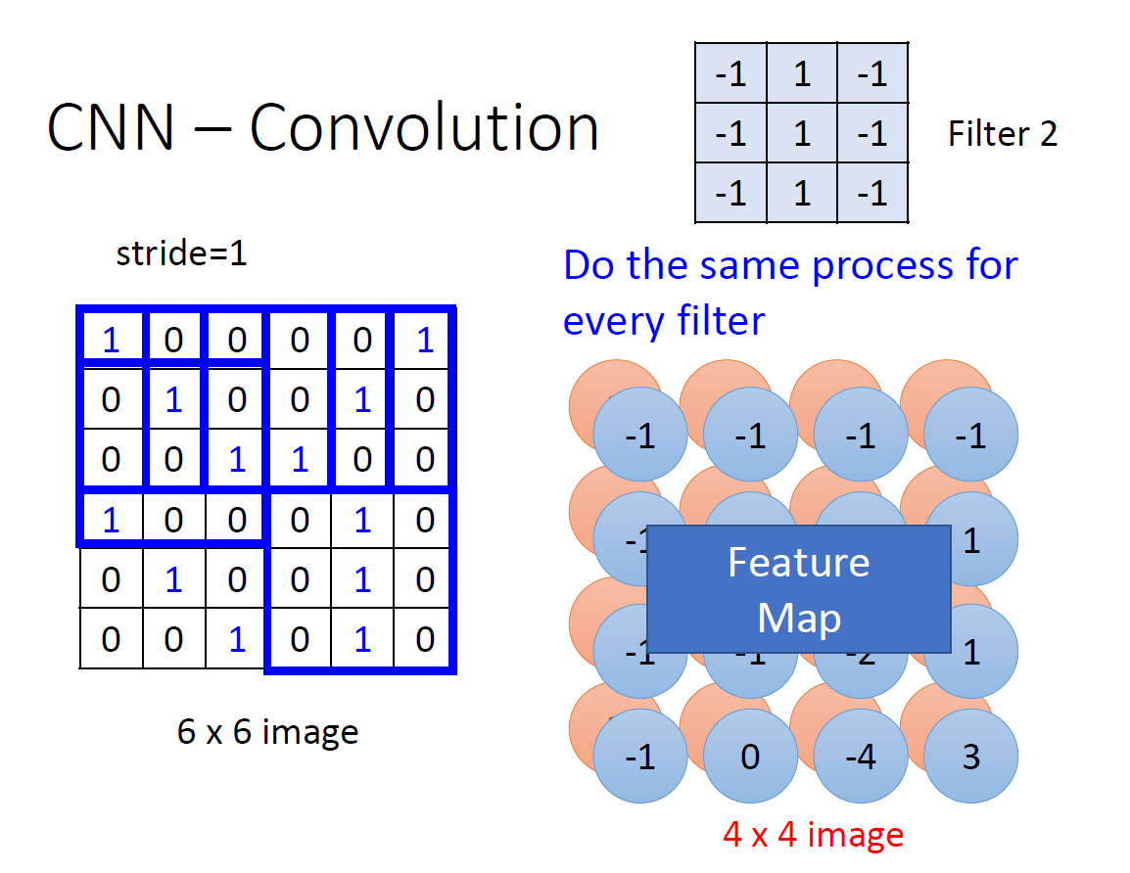
Convolutional Layers
Adjusted from Dr. Hung-yi Lee, Machine Learning slides

Slide 20
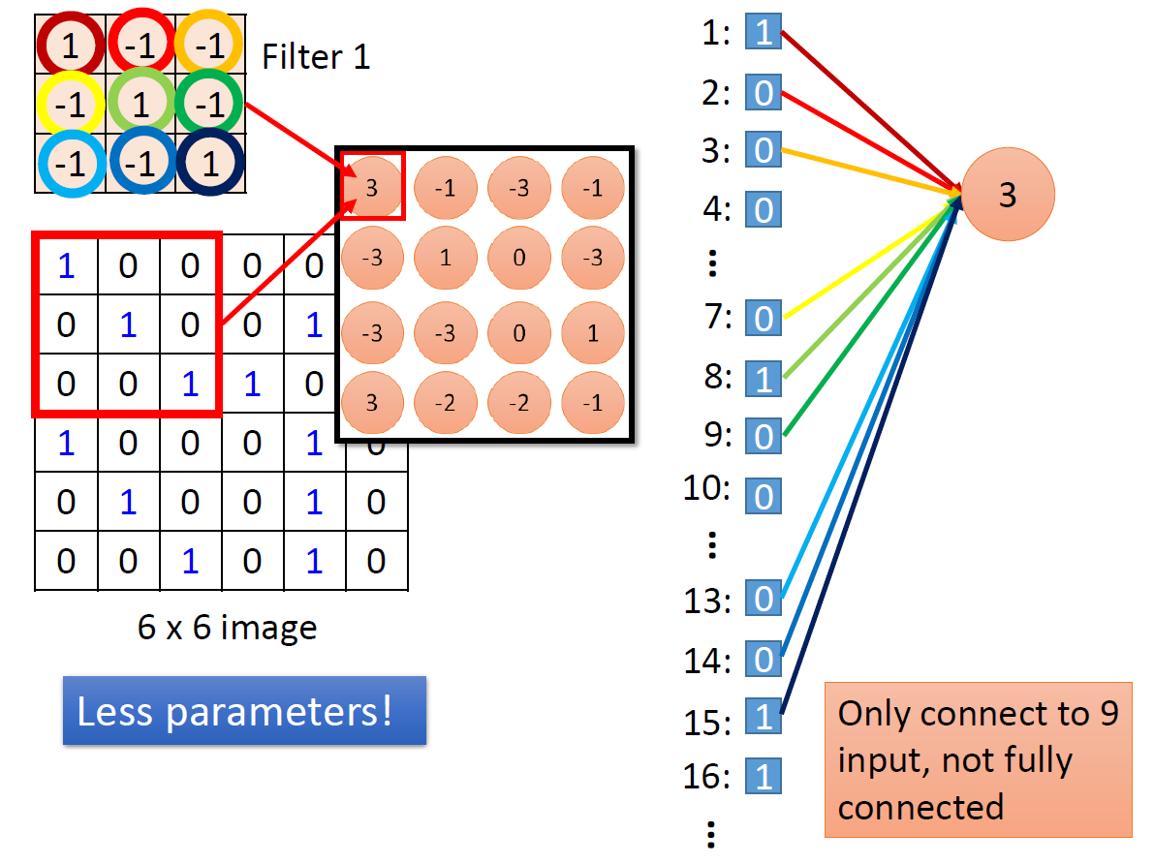
Convolutional Layers
Adjusted from Dr. Hung-yi Lee, Machine Learning slides

Slide 21
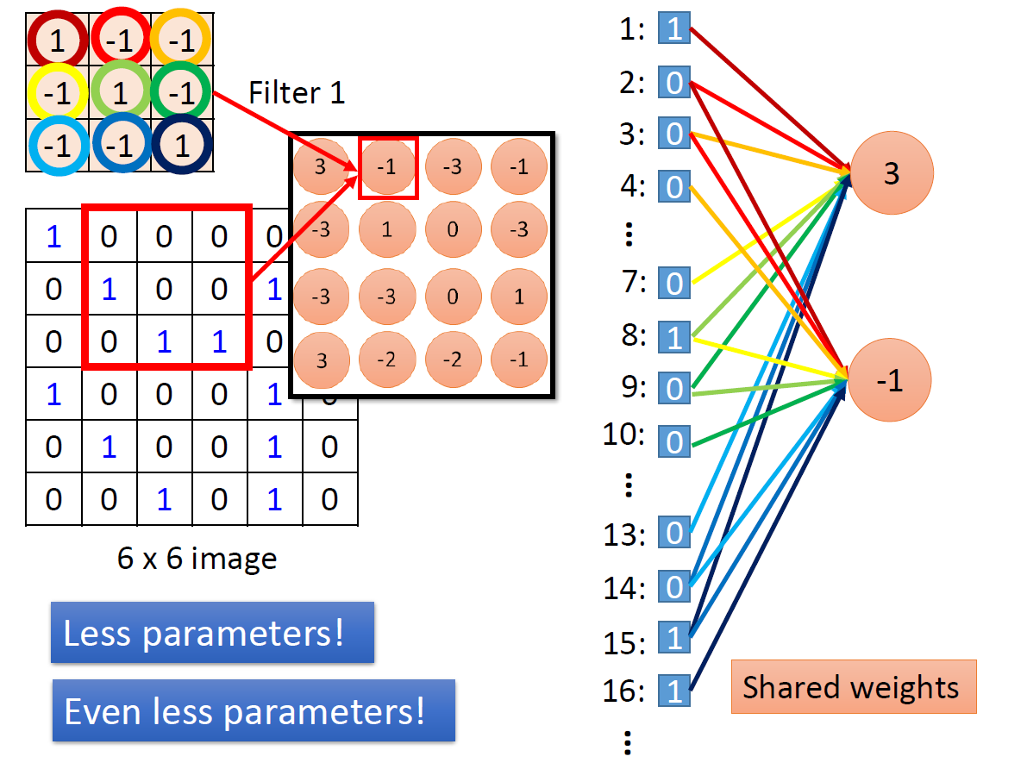
Convolutional Layers
Adjusted from Dr. Hung-yi Lee, Machine Learning slides

Slide 22
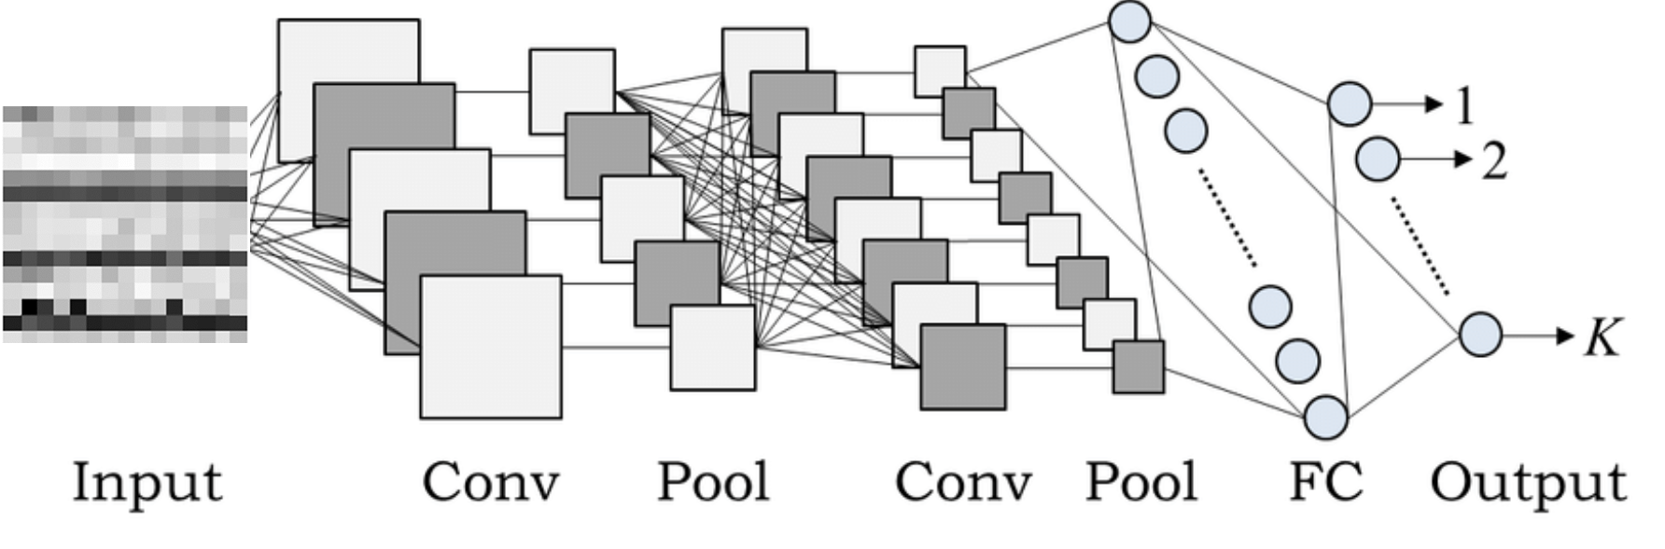
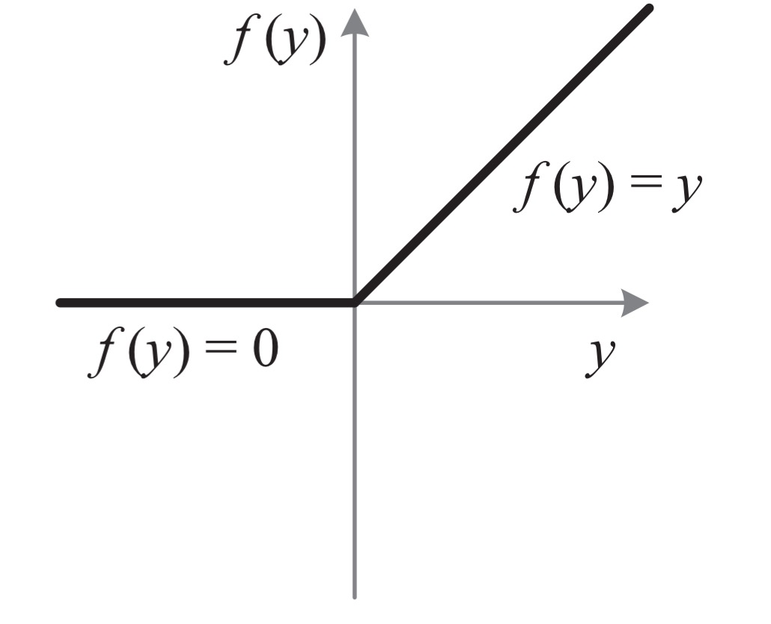
ReLU
rectified linear unit (ReLU)
Adjusted from Dr. Hung-yi Lee, Machine Learning slides

Slide 23
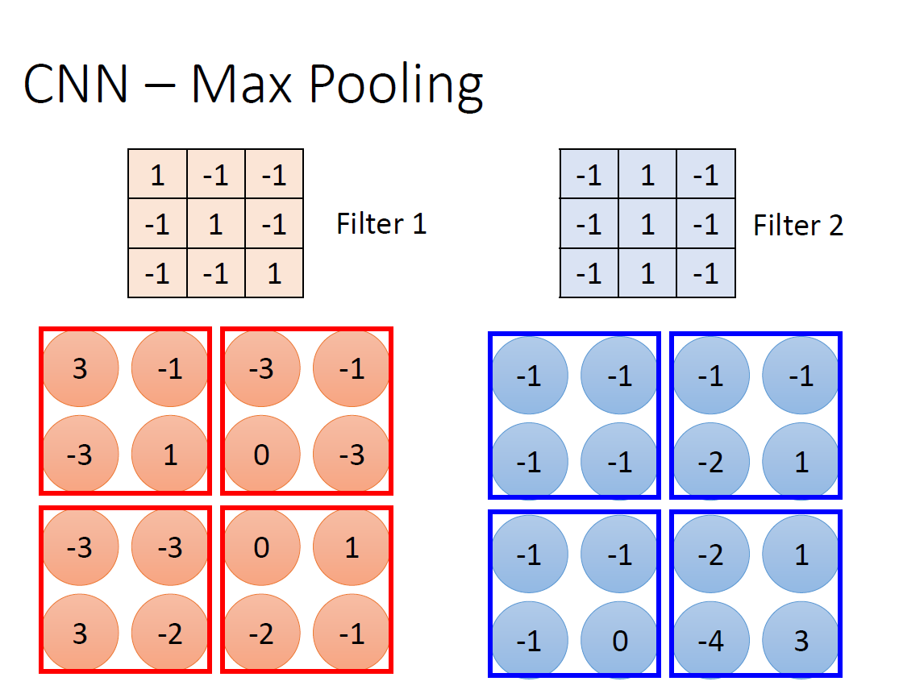
Max Pooling
Adjusted from Dr. Hung-yi Lee, Machine Learning slides

Slide 24
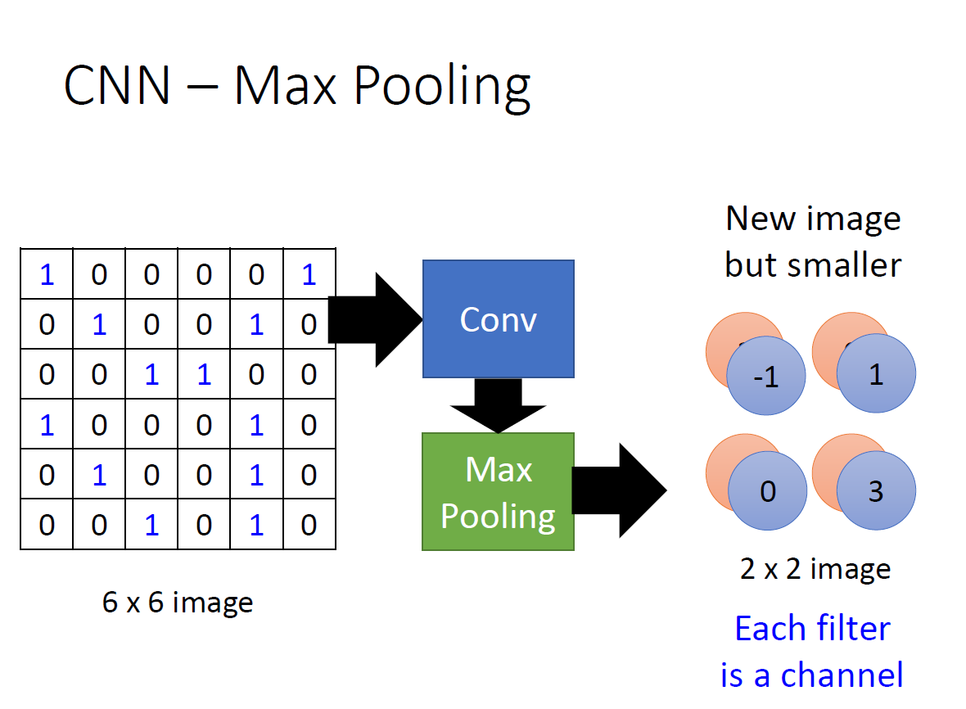
Max Pooling
Adjusted from Dr. Hung-yi Lee, Machine Learning slides

Slide 25
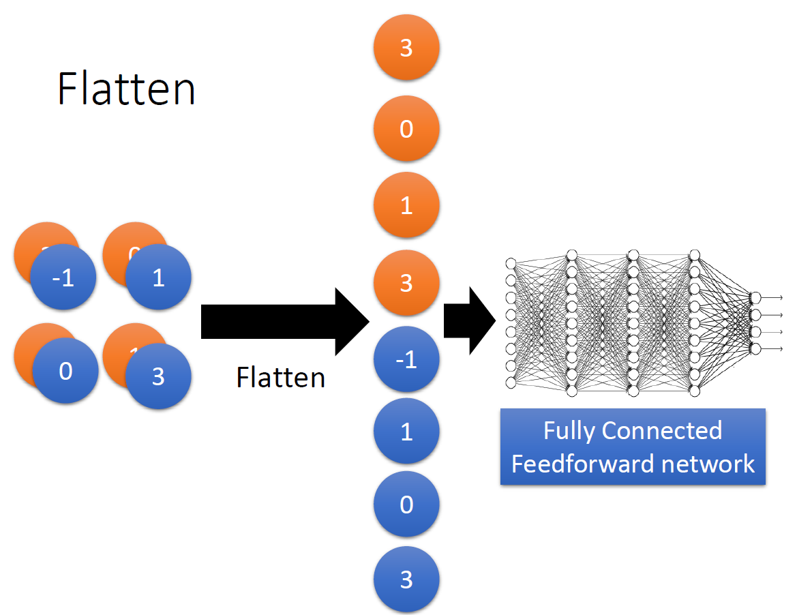
Flatten and Fully Connected
Adjusted from Dr. Hung-yi Lee, Machine Learning slides

Slide 26
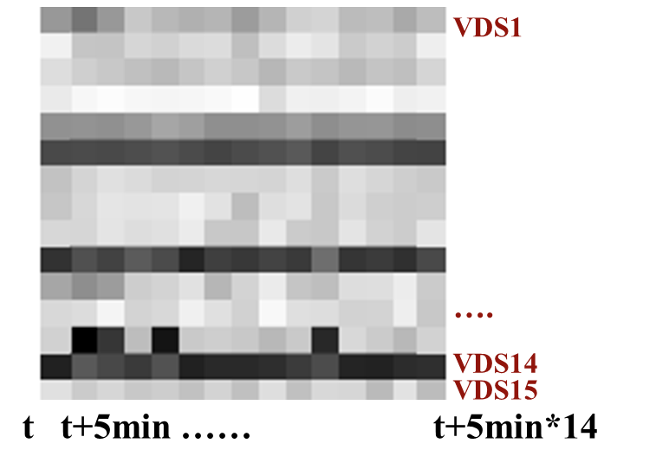
Traffic Information Detection by Filters
1 | 1 | 1
-1 | -1 | -1
-1 | -1 | -1
Bottleneck
1 | -1 | -1
1 | -1 | -1
1 | -1 | -1
Congestion
Speed Matrix
1 | -1 | -1
-1 | 1 | -1
-1 | -1 | 1
Back Propagation of Shock Wave

Slide 27
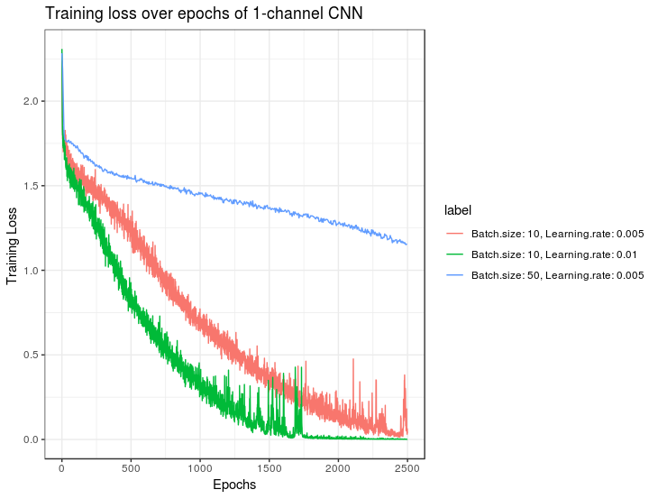
Batch size: 10 and Learning rate: 0.01 selected
1 – Channel CNN: Tuning the Network

Slide 28
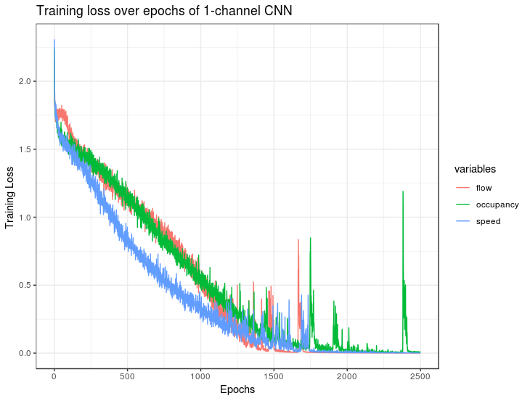
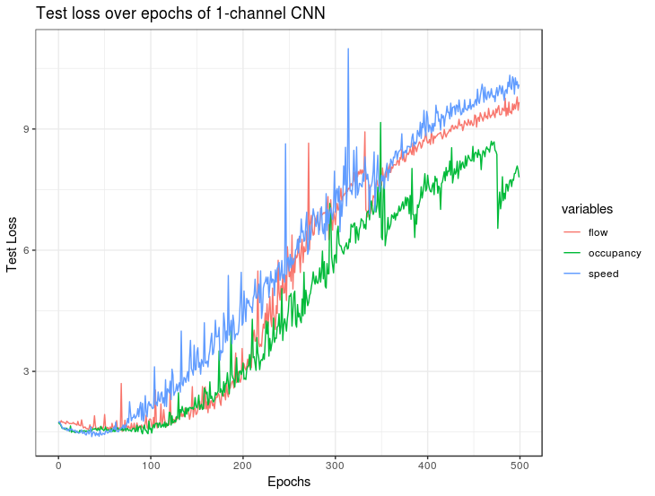
1 – Channel CNN
Training loss of 3 input variables
Test loss of 3 input variables

Slide 29
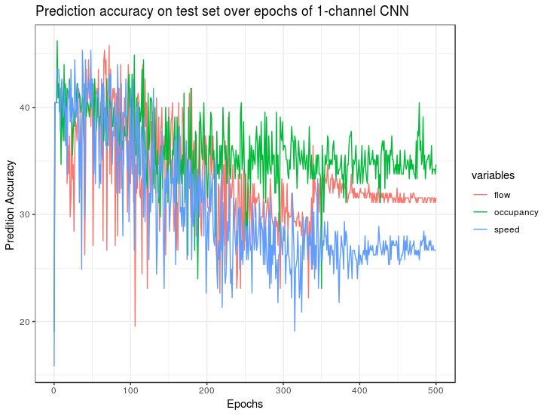
1 – Channel CNN
Prediction accuracy on test set (10/31/2018)

Slide 30
3 – Channel CNN
Speed
Flow
Occupancy

Slide 31
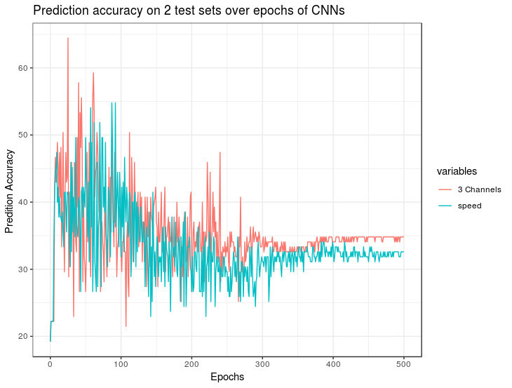
3 – Channel CNN
Prediction accuracy on 10/31 test set by 1-channel and 3-channel CNN

Slide 32
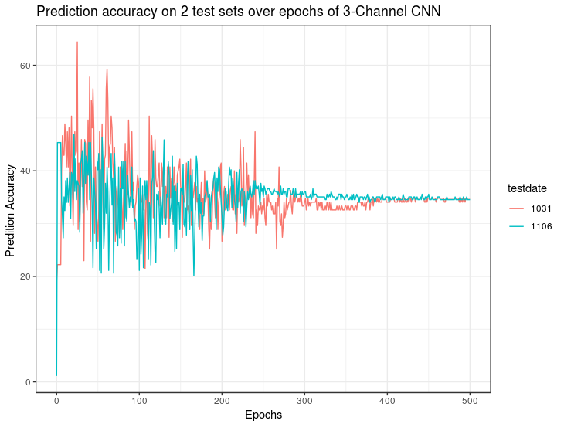
3 – Channel CNN
Performance on the test set(10/31) with the same observation rate is better than the one (11/06) with different observation rate
Prediction accuracy on 10/31 and 11/06 test sets by 3-channel CNN

Slide 33
4 – Channel CNN
Speed
Flow
Occupancy
Observation rate

Slide 34
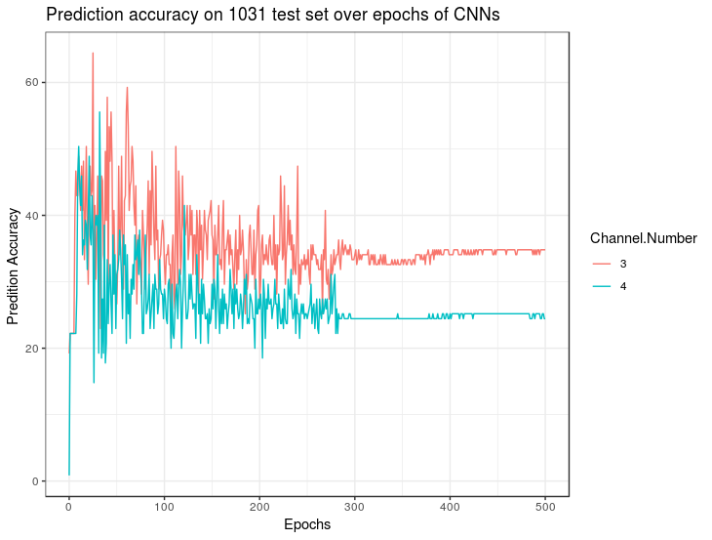
4 – Channel CNN
Prediction accuracy on 10/31 test set by 3-channel and 4-channel CNN

Slide 35
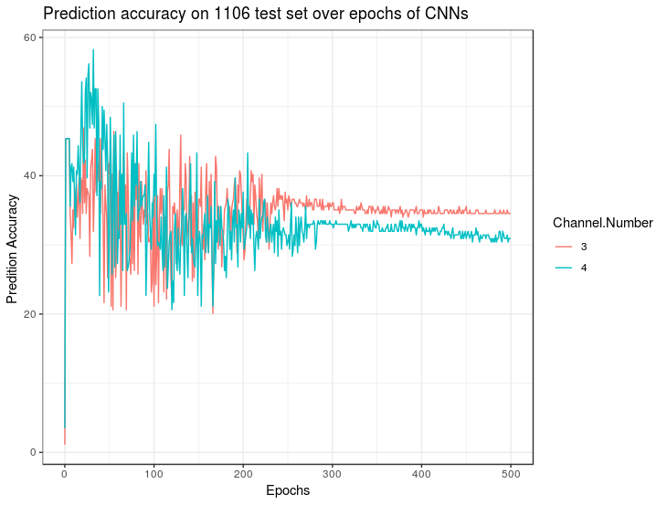
4 – Channel CNN
Prediction accuracy on 11/06 test set by 3-channel and 4-channel CNN

Slide 36
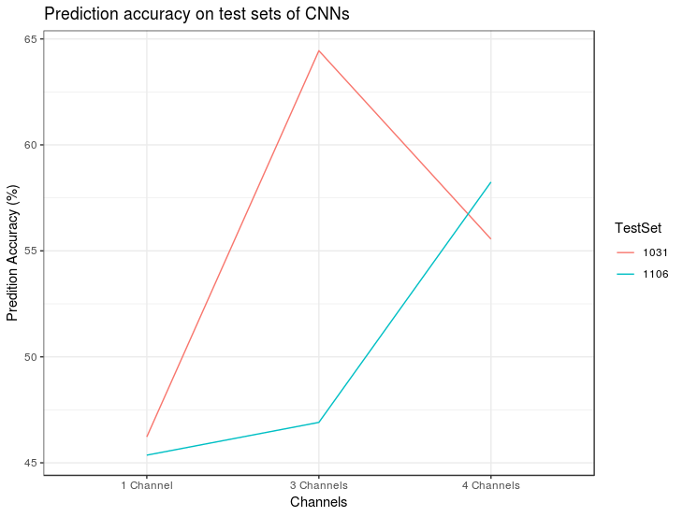
Performance of 3 CNNs
Prediction accuracy on two test sets by three CNNs

Slide 37
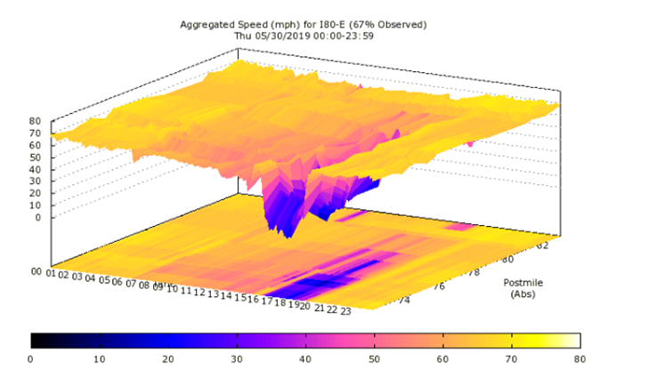
Potentials of CNNs
1. Handle temporal and spatial information simultaneously

Slide 38
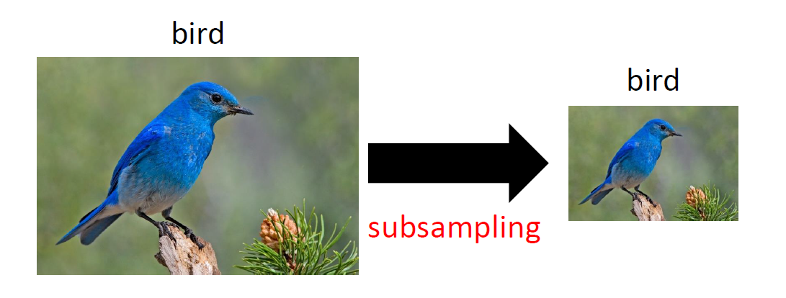
Potentials of CNNs
2. Max pooling layer makes analysis on large-scale travel time prediction possible

Slide 39
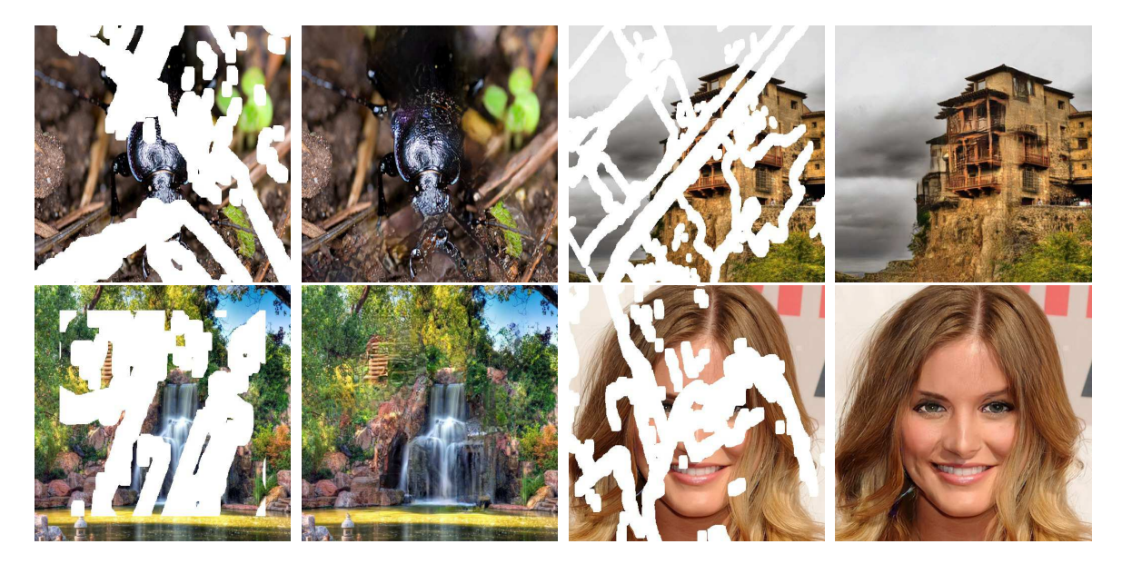
Potentials of CNNs
3. Be able to handle partially observed data (missing pixel values)
Source: NVIDIA

Slide 40
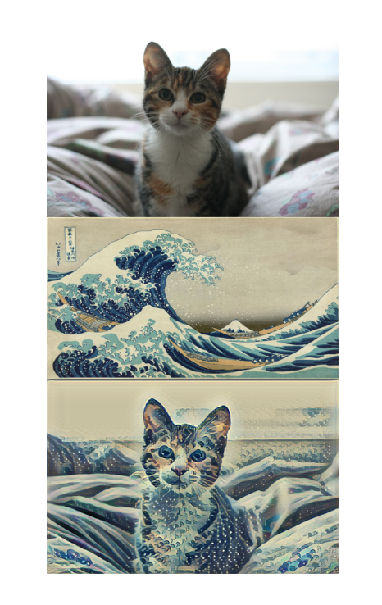

Thank You

